Slide 1
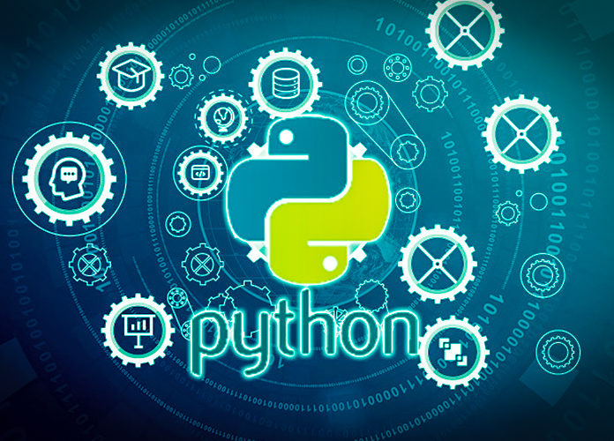
Data Programming in Python _________________ Booleans and Flow Control

Slide 2
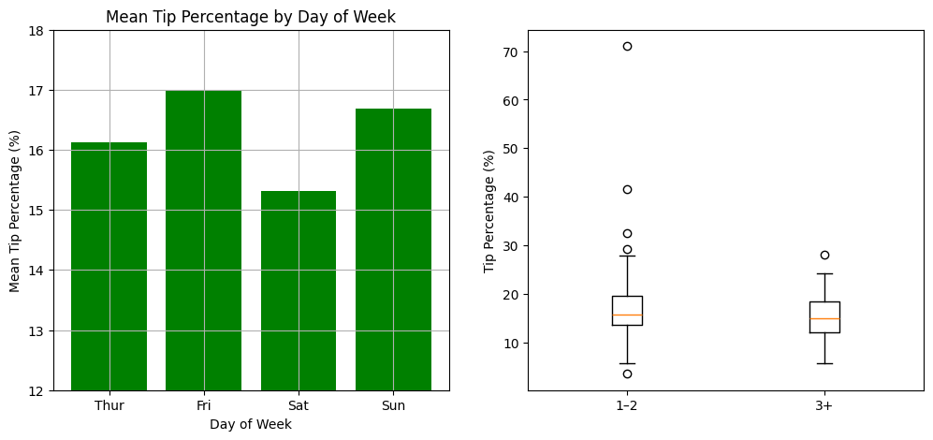
Visualizations in Python
Can be simple or more complex
Make sure to include titles, axis labels

Slide 3
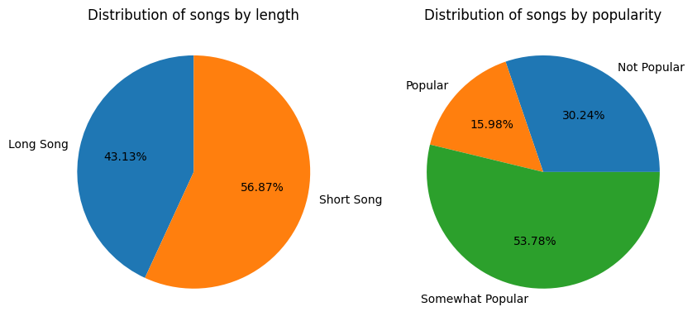
Matplotlib
Main, basic library in Python
Import matplotlib.pyplot as plt
plt.function

Slide 4
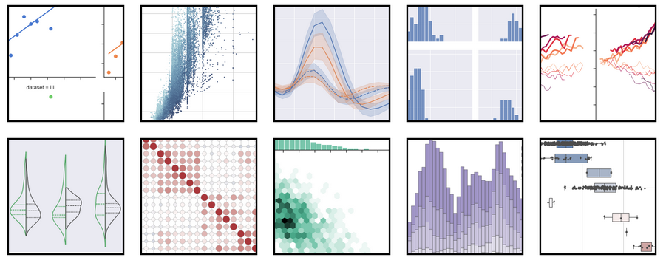
Seaborn
Elevated package of matplotlib
seaborn.pydata.org

Slide 5


Other visualization libraries
pyplot
Plotnine
Bokeh
Altair
Geoplotlib

